Slide 1


PREDICTIVE INSURANCE COST ANALYTICS
Multi-Linear Regression & OLS Validation Modeling
Prepared by: Protyay Chatterjee
MSc Data Science | St. Xavier's College

Slide 2
01 EXPLORATORY DATA ANALYSIS
Understanding Risk Drivers & Data Distributions

Slide 3

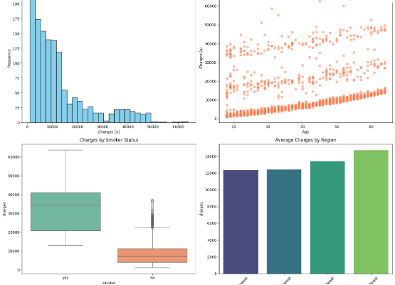

DISTRIBUTION OF CHARGES
The initial analysis of insurance charges reveals a high degree of skewness:
•
Right-Skewed Target: Majority of policies cluster in the low-cost bracket.
•
Heavy Tails: High-cost outliers reach up to $63,770, suggesting non-normal error distribution in OLS.
•
Volatility: Variance increases with premium levels, indicating potential heteroscedasticity.
Inference: Log-transformation is likely necessary to stabilize variance.

Slide 4

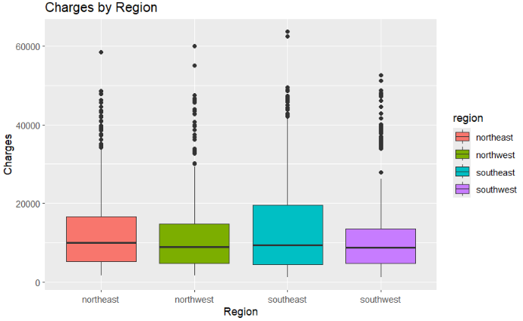
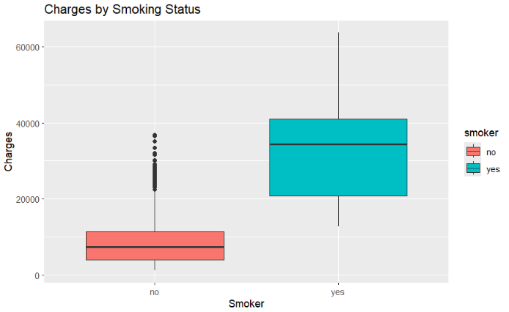
CATEGORICAL RISK DRIVERS
IMPACT OF SMOKING
REGIONAL VARIANCE
Smokers exhibit a massive premium gap compared to non-smokers, serving as the dominant cost driver.
Variance is visible across regions, with the Northeast showing a distinct upper-quartile trend.

Slide 5

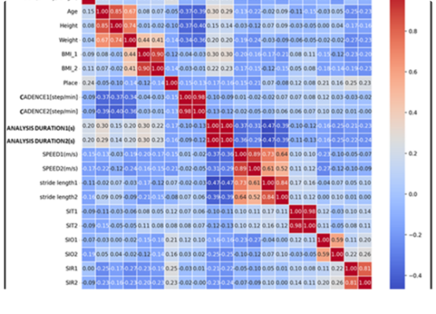
PREDICTOR INDEPENDENCE
VIF VALIDATION
Correlation analysis confirms the stability of our predictor space:
•
Independence: Age, BMI, and Children show correlations near zero.
•
VIF Scores: Values are near 1.0, ensuring no multicollinearity.
•
Coefficient Stability: Reliable p-values and slope estimates across iterations.

Slide 6
02 OLS THEORETICAL FOUNDATIONS
Proving Unbiasedness & Minimum Error Criterion

Slide 7


PROOF OF UNBIASED ESTIMATORS
SIMULATION RESULTS (N=1000)
259.28
Through 1,000 sampling iterations (n=50), the mean slope converged to the true population value:
Mean Estimated Slope
This demonstrates that while individual samples vary, OLS estimators remain fundamentally unbiased.

Slide 8
RSS MINIMIZATION PROOF
A grid search simulation for BMI vs. Charges proves the analytical OLS solution finds the global minimum.
Metric | Grid Search Result | Analytical OLS (lm)
Intercept (B0) | 13,260.22 | 13,270.42
Error Minimization | Global Minimum Found (Convex Optimization)
The extremely close proximity of the Grid Search to the OLS analytical solution validates the Least Squares Criterion.

Slide 9

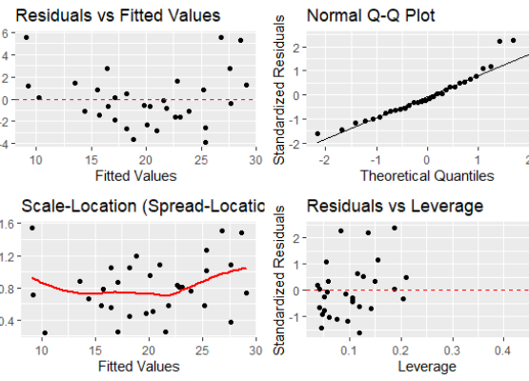
DIAGNOSTIC HEALTH CHECK
VIOLATIONS DETECTED
•
Three-Band Pattern: Signals uncaptured interactions between Smoker/BMI.
•
Heteroscedasticity: Variance increases with fitted values, making p-values unreliable.
•
Heavy Tails: Right tail deviation indicates non-normally distributed residuals.
Conclusion: Raw MLR is statistically unstable.

Slide 10


THE LOG-TRANSFORM SOLUTION
MATHEMATICAL FIX
DIAGNOSTIC RECOVERY
By transforming to log(charges), we compress the extreme distance of outliers.
Bands collapsed into a random cloud.
Normal Q-Q plot straightened.
Percentage-based risk assessment enabled.

Slide 11
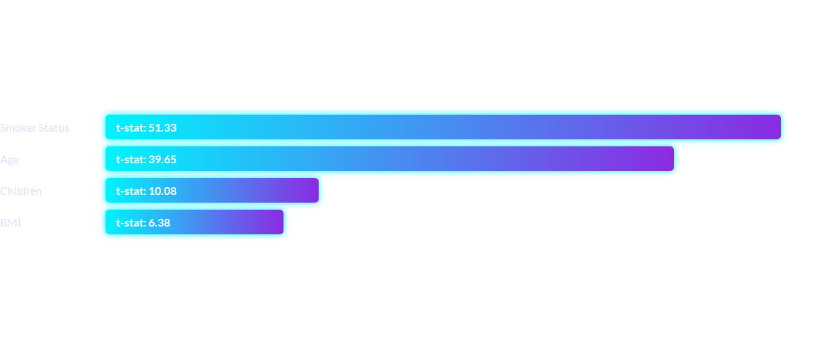
MODEL SELECTION & OPTIMIZATION
Stepwise Selection (AIC-based) confirmed that all predictors are significant drivers of insurance cost.
Adjusted R² peaked at 0.767 after Stepwise optimization.

Slide 12


SYNTHESIS & CONCLUSION
The transition from a Raw Multiple Linear Regression to a Log-Transformed Stepwise Model was the defining success of this project. While the initial model achieved a high R² (0.75), it violated core OLS assumptions, rendering its predictions statistically unstable.
TECHNICAL INFERENCES
FINAL RESULT
Correction of Heteroscedasticity: The initial "three-band" residual pattern was successfully resolved. Normalization of Errors: By pulling high-cost outliers closer to the mean, we satisfied the normality assumption. Interpretability: Shifting to a log-scale allowed for a percentage-based interpretation (e.g., 3.5% increase per year of age).
Through Stepwise Selection and Best Subset analysis, all predictors—age, bmi, children, smoker, sex, and region—were proven significant cost drivers. The final model provides a robust, balanced framework for predictive accuracy, evidenced by the improved RMSE on the test set.

